Slide 1
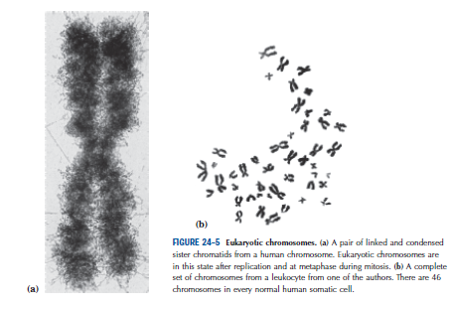
Eukaryotic chromosome
Lecture - 5
“Microscopy has long been used to observe chromosome structure and function. Indeed, long before it was clear that chromosomes were the source of the genetic information in the cell, their movements and changes during cell division were well-understood. The compact nature of condensed mitotic or meiotic chromosomes makes them relatively easy to visualize even by simple light microscopy.”

Slide 2
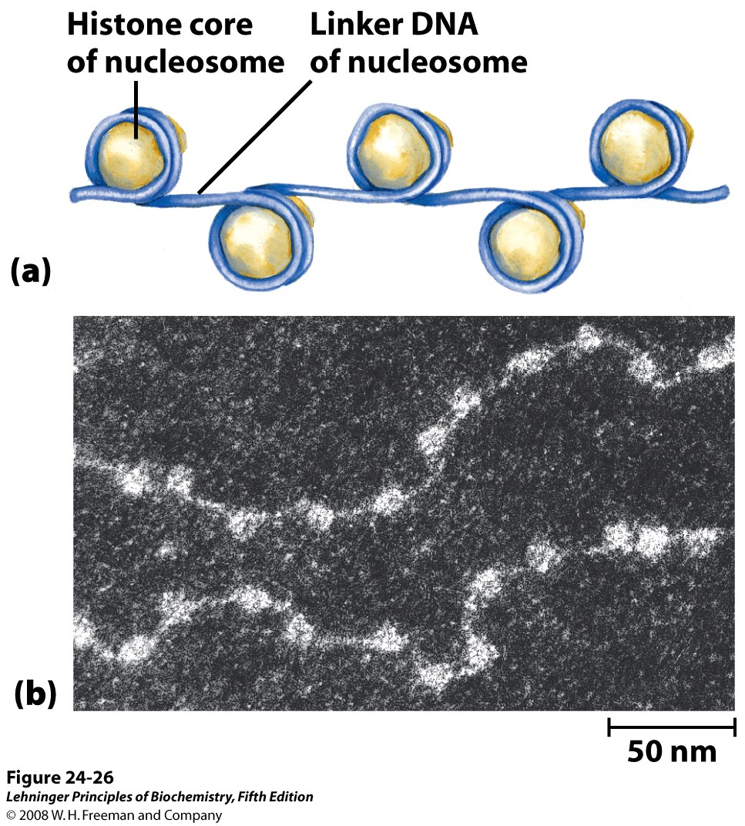
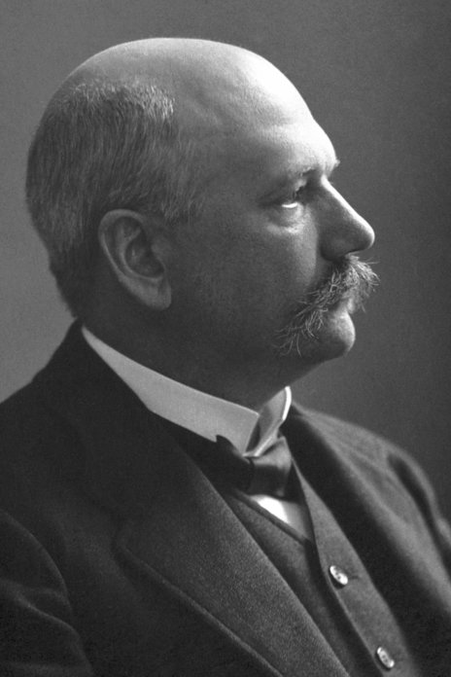
Nucleosomes: structural unit of chromosome
Histones, first discovered by Albrecht Kossel in 1884, are highly conserved, alkaline, positively charged proteins
Nobel Prize, 1910

Slide 3
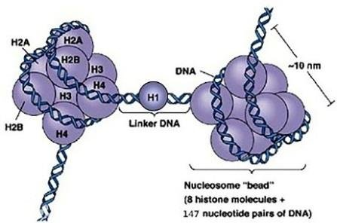
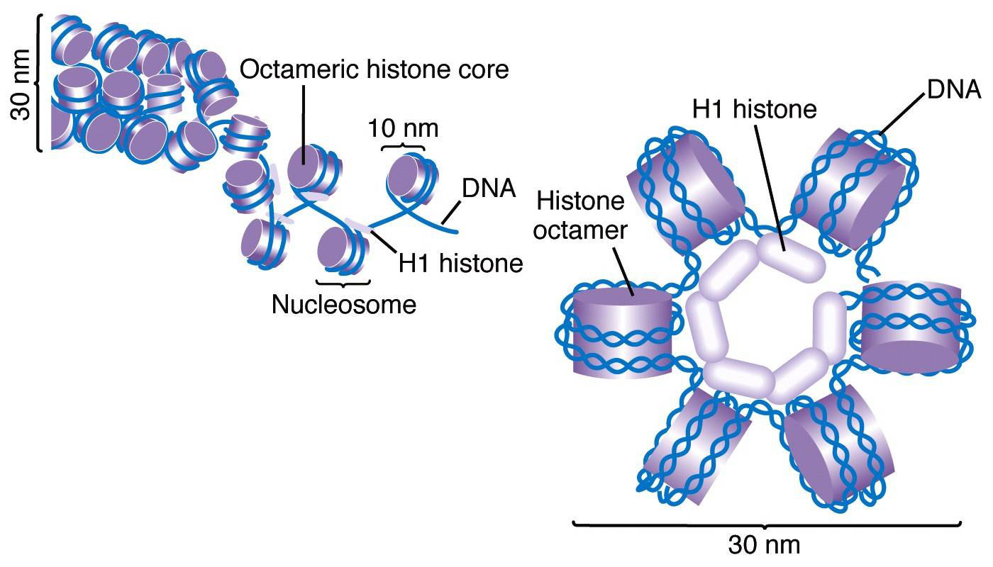
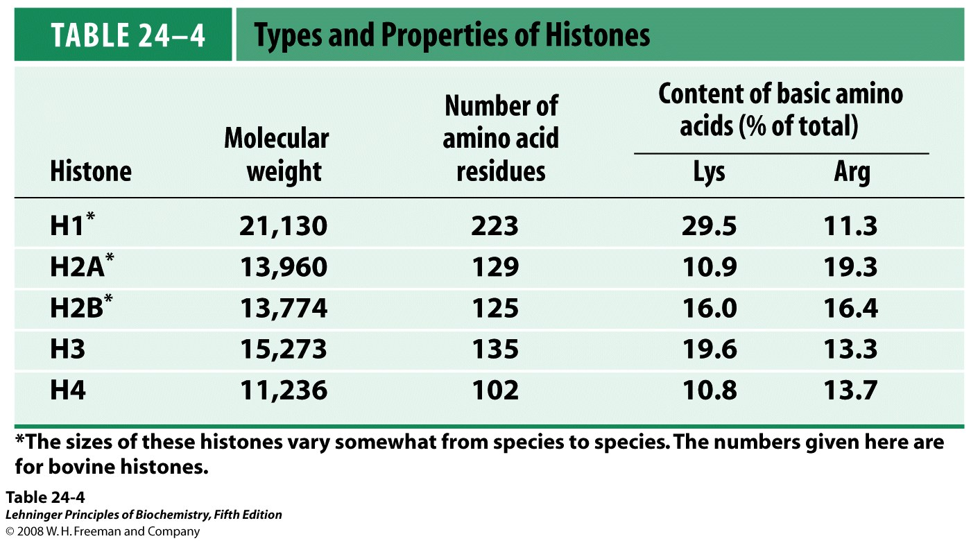
Histone binding to DNA
At least 20% of the residues in each histone are either lysine or arginine.

Slide 4
Nuclease digestion of chromosome

Slide 5
Interactions of histones with DNA

Slide 6
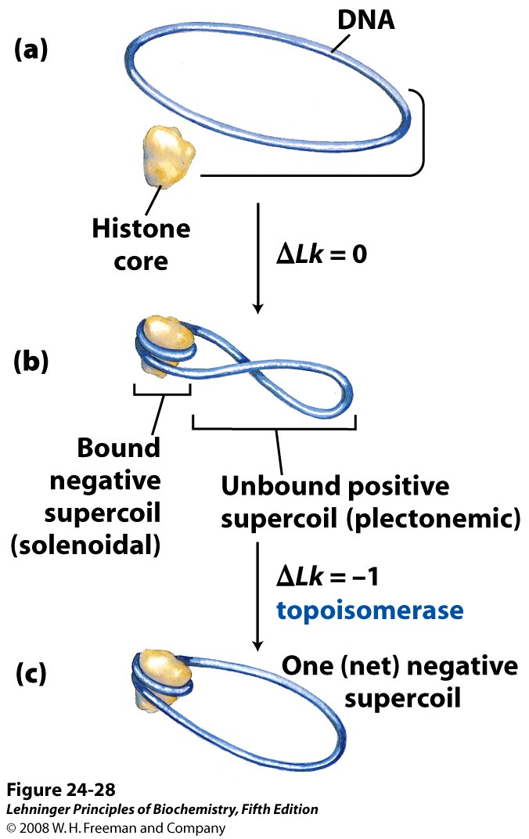
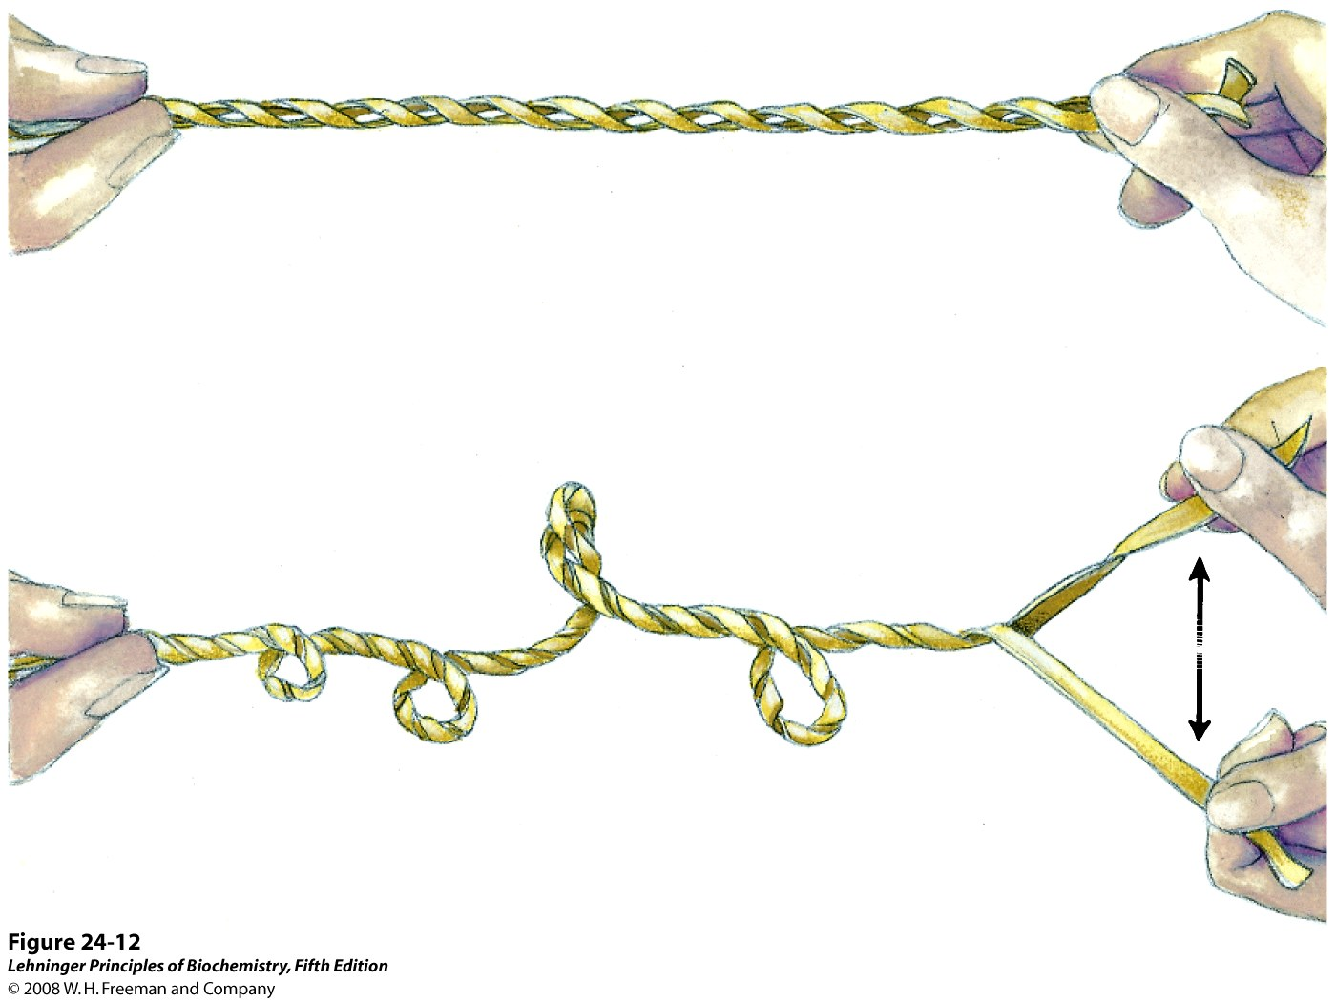
Chromatin assembly
The tight wrapping of DNA around the histone core requires the removal of about one helical turn in the DNA.
Notes:
When the
protein core of a nucleosome binds in vitro to a relaxed,
closed-circular DNA, the binding introduces a negative
supercoil. Because this binding process does not break
the DNA or change the linking number, the formation
of a negative solenoidal supercoil must be accompanied
by a compensatory positive supercoil in the unbound region
of the DNA (Fig. 24–28). As mentioned earlier, eukaryotic
topoisomerases can relax positive supercoils.
Relaxing the unbound positive supercoil leaves the negative
supercoil fixed (through its binding to the nucleosome
histone core) and results in an overall decrease
in linking number.

Slide 7
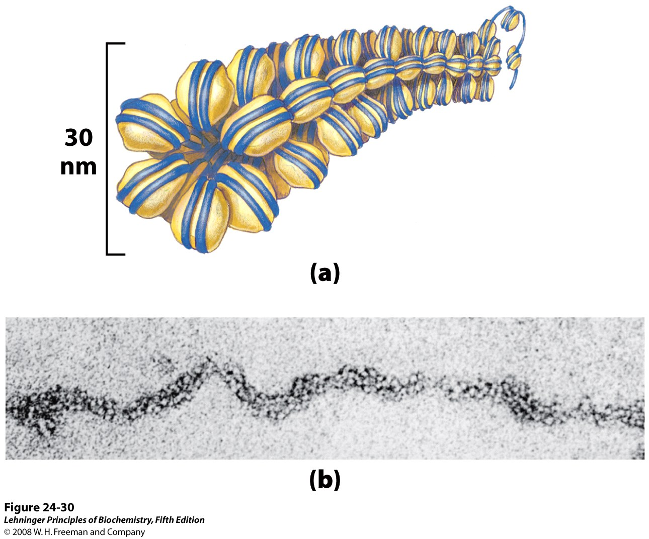
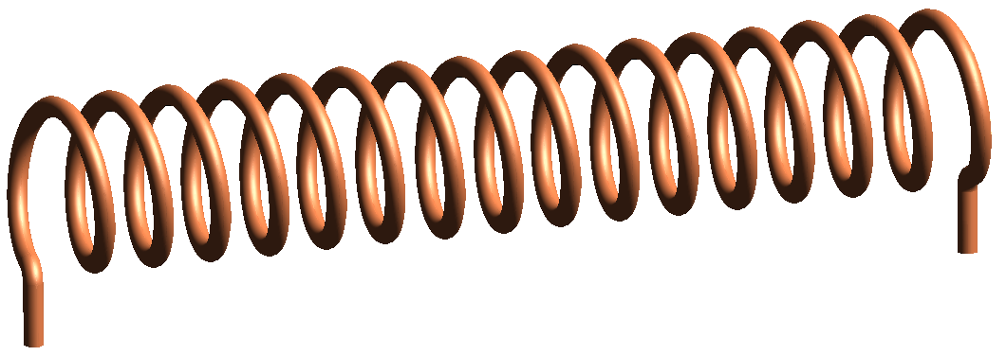
Higher order organization of nucleosomes
Structural maintenance of chromosomes (SMC) proteins

Slide 8
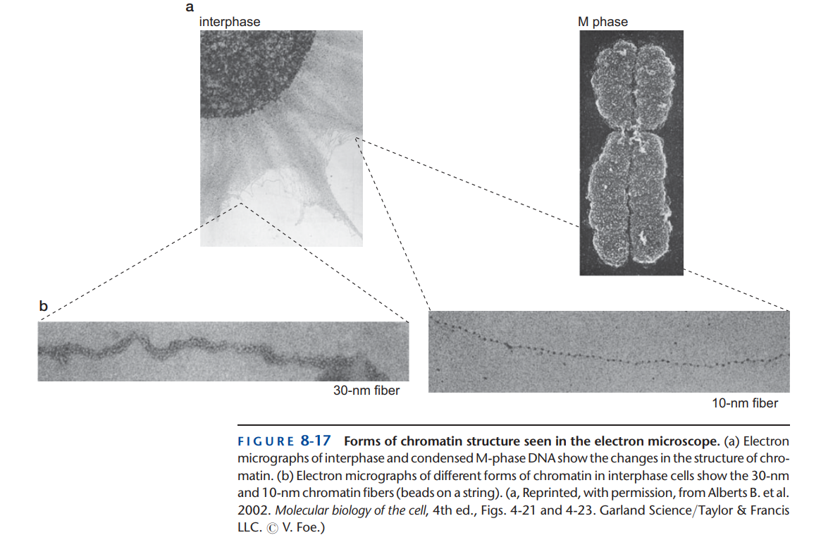
In any cell, there are stretches of DNA that are not packaged into nucleosomes. Typically, these are regions of DNA engaged in gene expression, replication, or recombination. Although not bound by nucleosomes, these sites are typically associated with nonhistone proteins that are either regulating or participating in these events

Slide 9
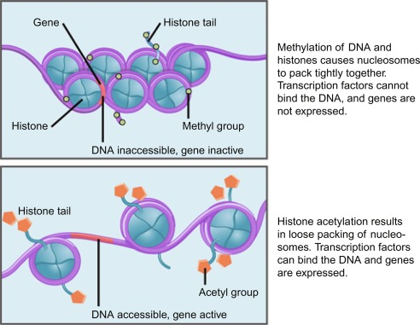
Heterochromatin vs euchromatin
Epigenetic regulation
Heterochromatin
Euchromatin

